Slide 1
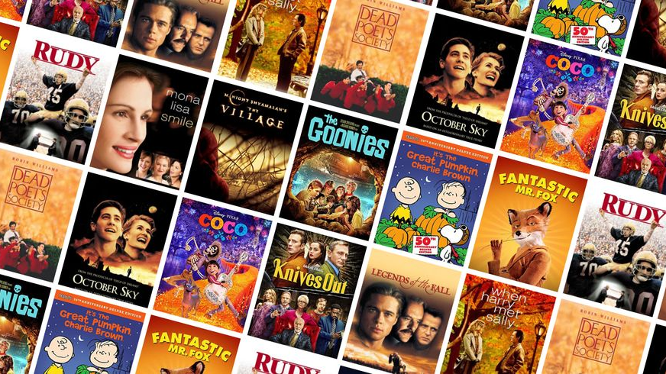

IMDB 2021 TOP 250 MOVIES DATABASE ANALYSIS
STA 6233 Zhang Zhang

Slide 2
Project Interest
I am a movie lover. My project focus on the 2021 top 250 movies on IMDb. IMDb (an abbreviation of Internet Movie Database) is an online database of information related to films, television series, home videos, video games, and streaming content online – including cast, production crew, and personal biographies, plot summaries, trivia, ratings, and fan, and critical reviews.
Research questions:
Distribution of movies by genre.
Top 10 most popular movies by vote.
Which genre had the longest runtimes?
Which certificate had the longest runtimes?
Which genre has the highest rate?
Which genre has the highest vote?

Slide 3
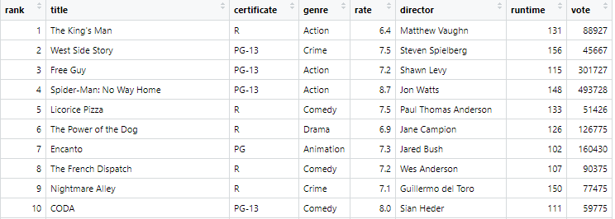
Website Scraped
Web scraping: https://www.imdb.com/search/title/?title_type=feature&release_date=2021-01-01,2021-12-31&count=250&ref_=adv_prv
2021 Top
250 Movies Database
Scrape 8 Variables
Graphs & Conclusions

Slide 4
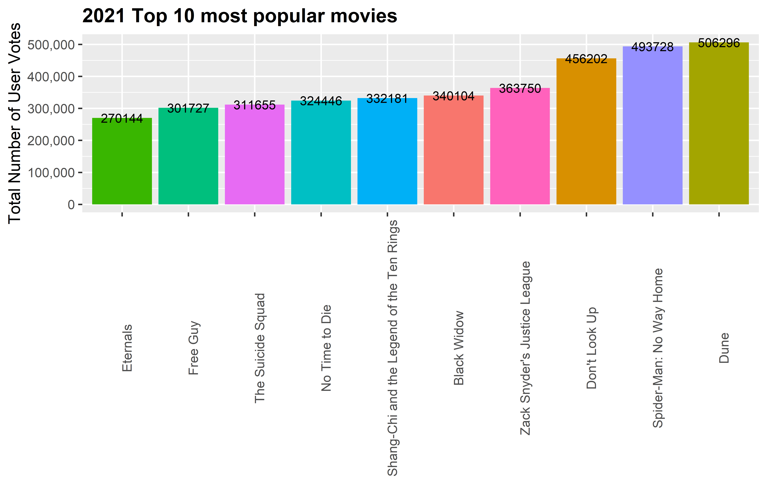
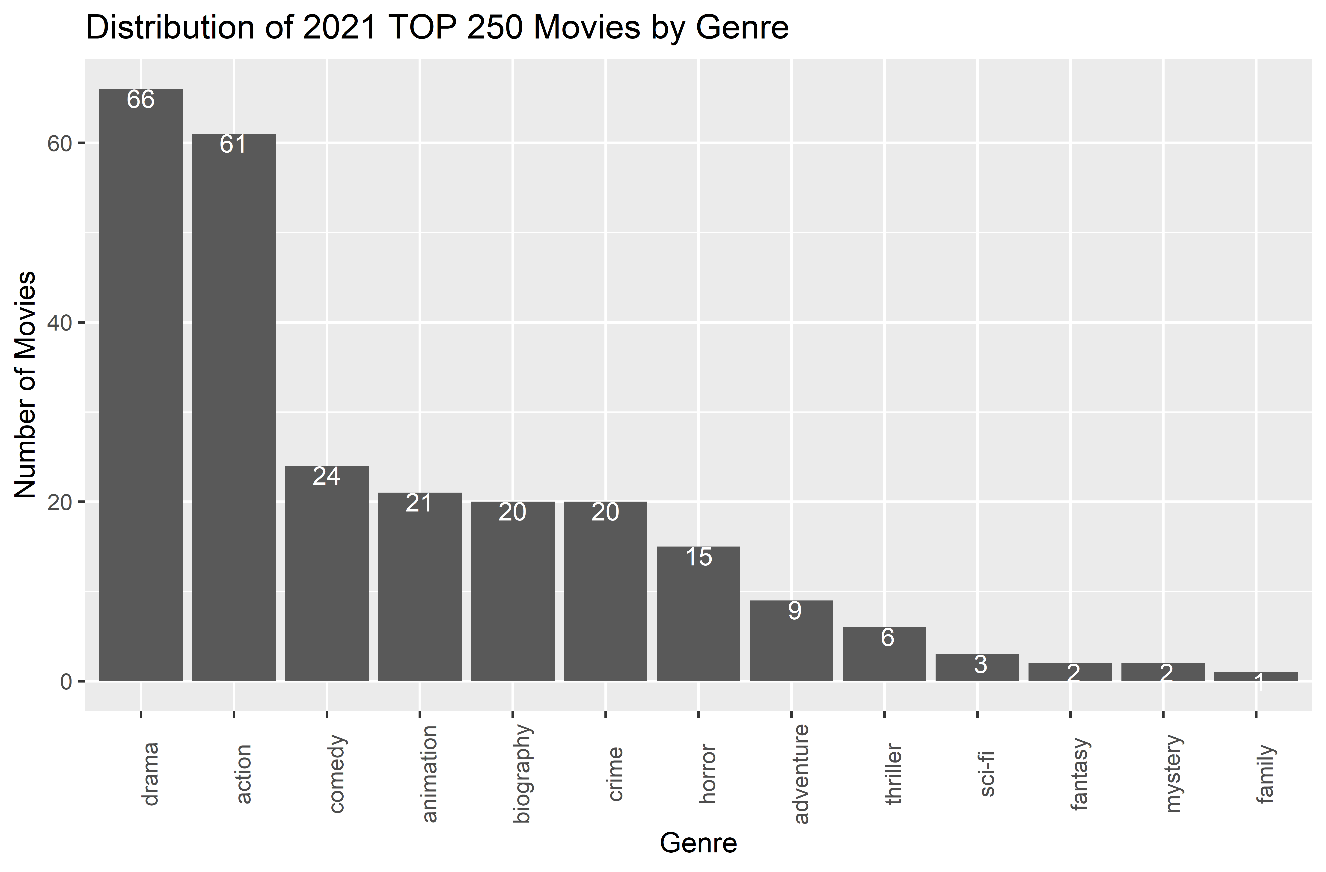
Graphs & Conclusions
Distribution of movies by genre.
Top 10 most popular movies by vote.

Slide 5
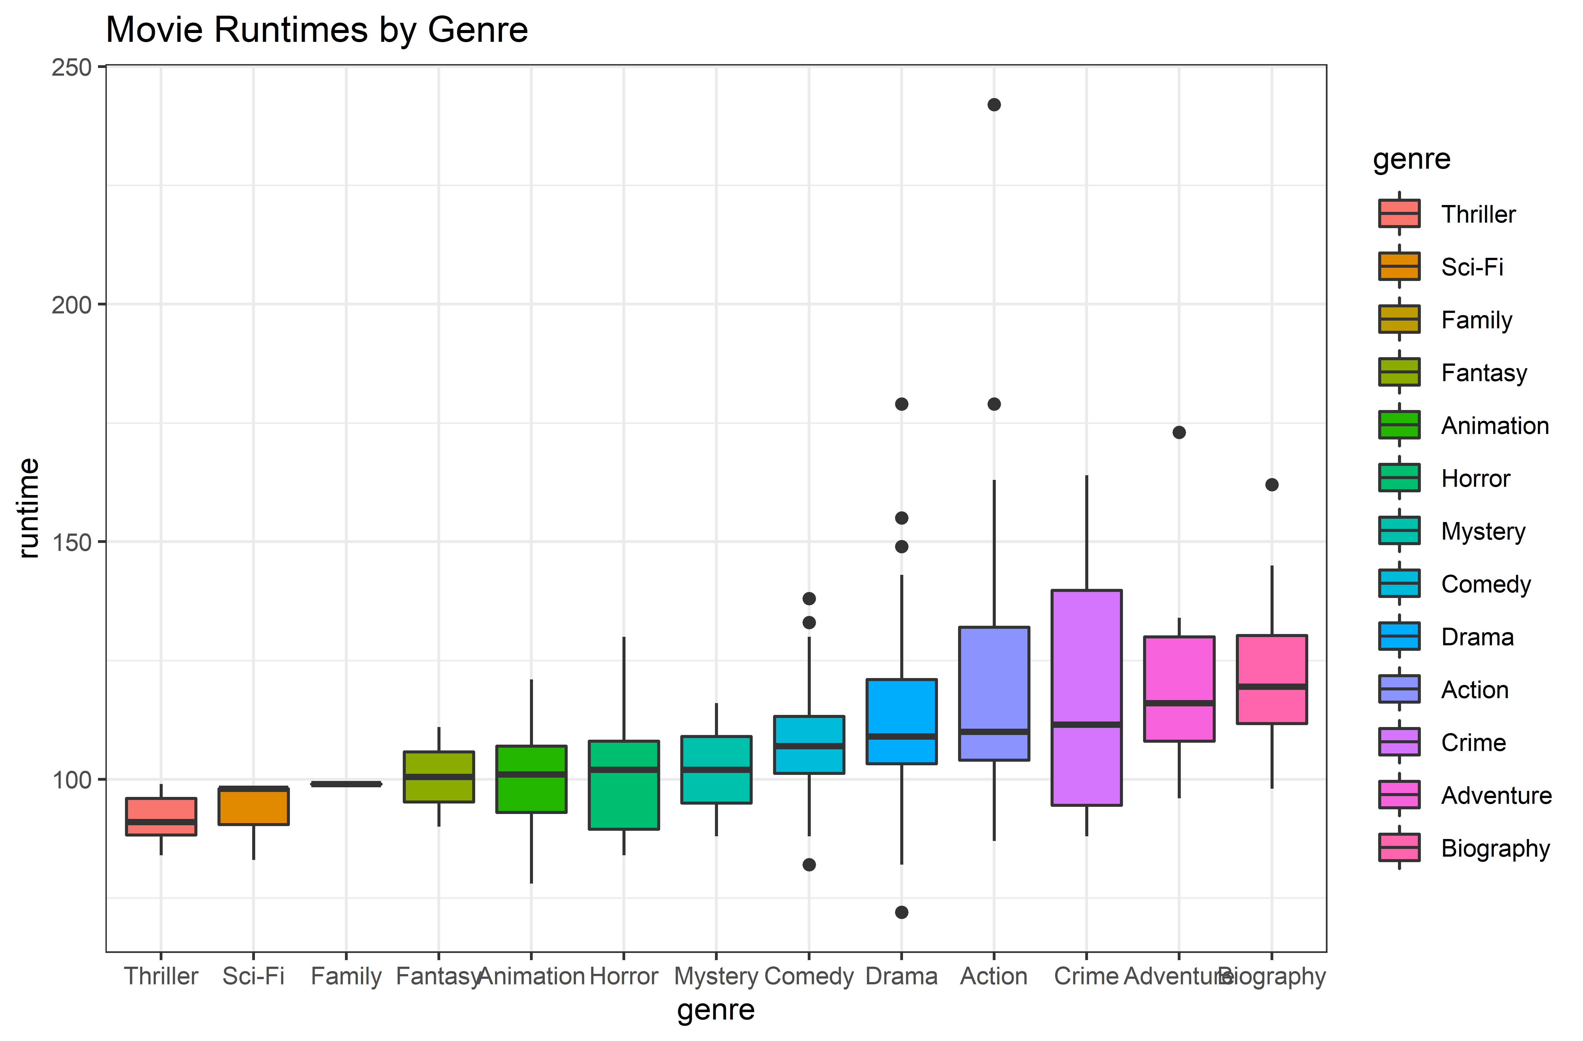
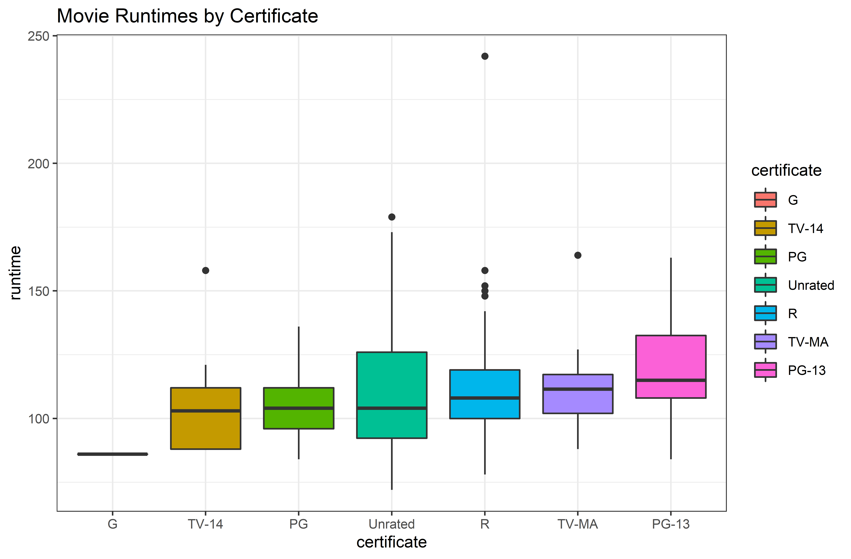
Graphs & Conclusions
3. Which genre has the longest runtimes? ------ Action
4. Which certificate has the longest runtimes? ------ R

Slide 6
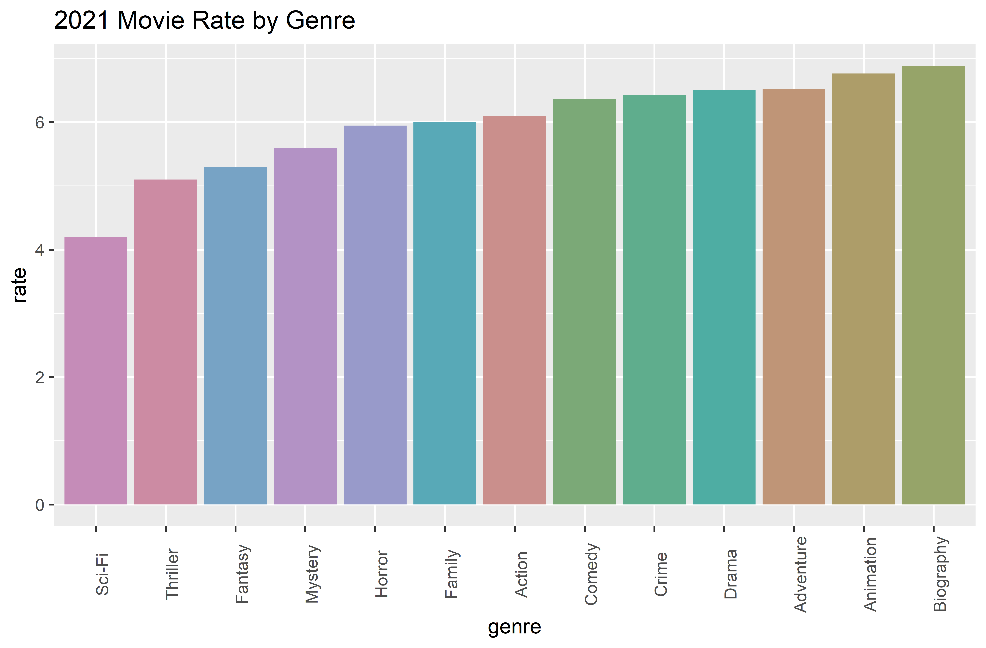
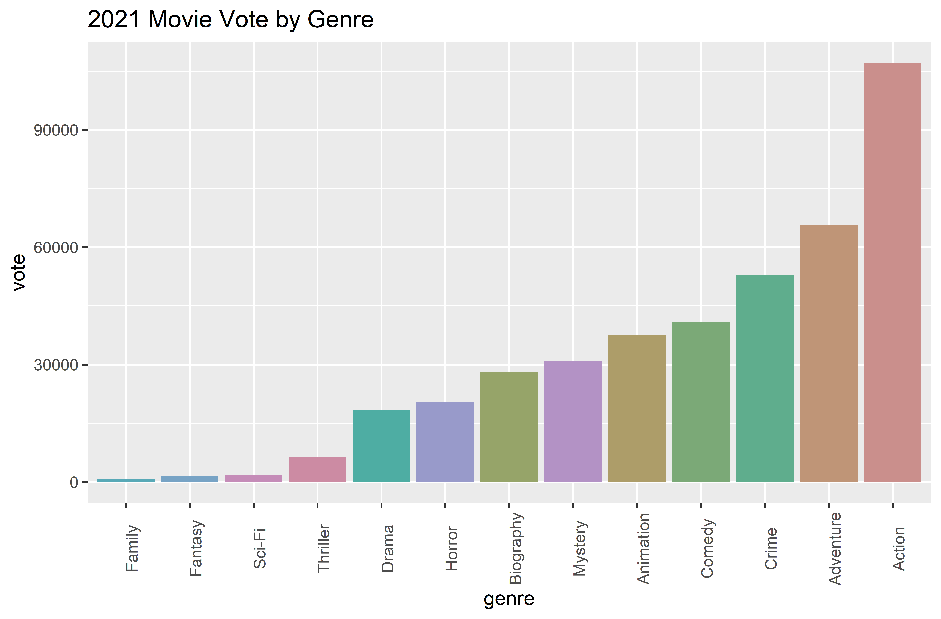
Graphs & Conclusions
5. Which genre has the highest rate? ------ Biography
6. Which genre has the highest vote? ------ Action

Slide 7
Thank you!

